Slide 1





Spatial Responses to Climate Across Trophic Levels:
Monitoring and Modeling Plants, Prey, and Predators in the Intermountain Western United States
2015 Research Progress Review
22-23 April 2015, College Park, MD
NASA Funding Opportunity #NNH11AR55I
Contact info:
Thomas Edwards t.edwards@usu.edu
2015 Research Progress Review, College Park, MD 22-23 April 2015
NASA Funding Opportunity #NNH11AR55I

Slide 2
Research Teams
University of Maryland, Global Land Cover Facility, College Park, MD
  Joe Sexton, Jyothy Nagol, Anupam Anad, Maosheng Zhoa
U.S. Geological Survey, Southwest Biological Science Center, Flagstaff, AZ and U.S. Geological Survey, Western Ecological Science Center, Las Vegas, NV
  David Mattson (ret.), Kirsten Ironside (AZ), Kathy Longshore (NV), David Choate (NV)
U.S. Geological Survey, Utah Cooperative Fish and Wildlife Research Unit, & Utah State University, Logan, UT
  Thomas Edwards, David Stoner, Andrew Sims
2015 Research Progress Review, College Park, MD 22-23 April 2015
NASA Funding Opportunity #NNH11AR55I

Slide 3
Core Research Progress
Last year of research – emphasis entirely on paper submissions and presentations at meetings
  Today – an overview of paper as vignettes
Research elements for which papers are in review, or all data analyses have been completed and we have internal drafts:
  #1: Effects of Topography on the Responses of Ecosystems to Drought
  #2: Retrieving Specific Plant Phenologies by Spectral Unmixing
  #3: Environment and Detection Biases in GPS Collars
2015 Research Progress Review, College Park, MD 22-23 April 2015
NASA Funding Opportunity #NNH11AR55I

Slide 4
Core Research Progress
Research elements for which papers are in review, or all data analyses have been completed and we have internal drafts:
  #4: Using NDVI to measure trade-offs between prey foraging and predator avoidance
  #5: Mammalian Reproduction Tracks Plant Phenology Across a Latitudinal Gradient
  #6: Model deer population dynamics based off primary productivity and climate
  #7: Forage quality, reproduction, and climate effects on ungulate habitat use and migration
2015 Research Progress Review, College Park, MD 22-23 April 2015
NASA Funding Opportunity #NNH11AR55I

Slide 5
Core Research Progress
… and in the “in prep” pipeline …
  #8: Movement and space selection in a dynamic resource environment
… all of which is to be finished with the “Mother of All Study Synthesis” reports for Woody !!
  By acronym MASS, it will have a substantial one …
2015 Research Progress Review, College Park, MD 22-23 April 2015
NASA Funding Opportunity #NNH11AR55I

Slide 6
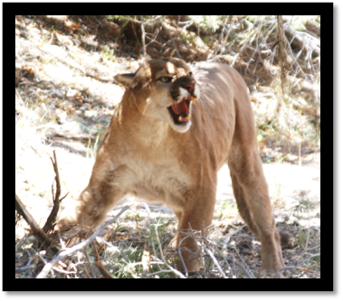

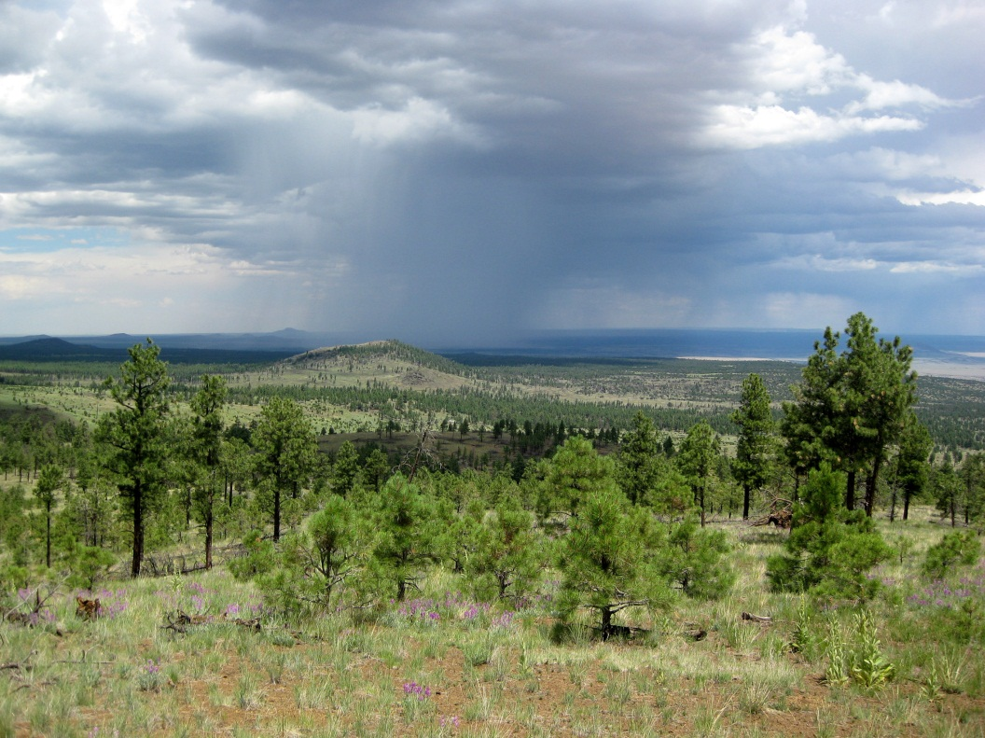
Overall Objectives
Scientific: understand climate effects on the ecosystem
  Direct: spatial patterns at each trophic level
  Indirect: transmission between trophic levels
Technical: methodology of modeling a spatio-temporally extensive ecosystem
  Link data and models
  Estimate and communicate uncertainty
Predator Density & Distribution
Prey Density & Distribution
Climate & Weather
Topography
Primary Productivity
2015 Research Progress Review, College Park, MD 22-23 April 2015
NASA Funding Opportunity #NNH11AR55I

Slide 7
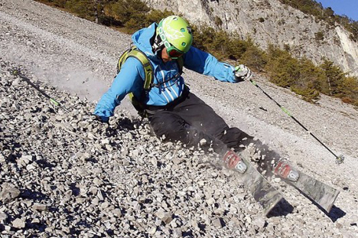
Overall Objectives
Don’t forget this “trophic” level and climate change, too!
Scientific: understand climate effects on the ecosystem
  Direct: spatial patterns at each trophic level
  Indirect: transmission between trophic levels
Technical: methodology of modeling a spatio-temporally extensive ecosystem
  Link data and models
  Estimate and communicate uncertainty
Predator Density & Distribution
Prey Density & Distribution
Climate & Weather
Topography
Primary Productivity
2015 Research Progress Review, College Park, MD 22-23 April 2015
NASA Funding Opportunity #NNH11AR55I

Slide 8
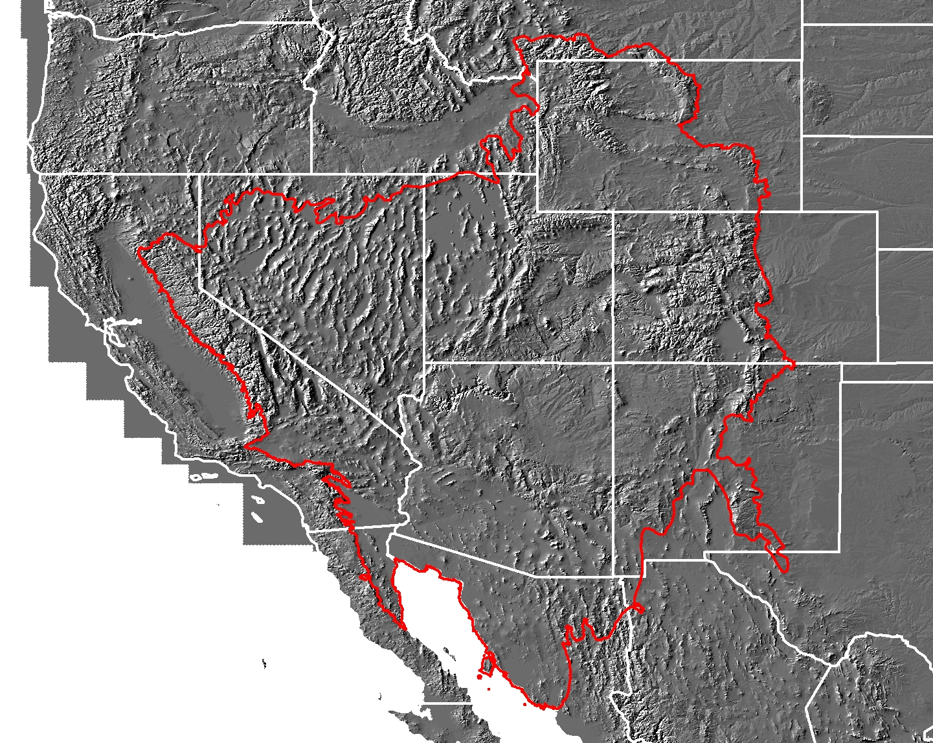
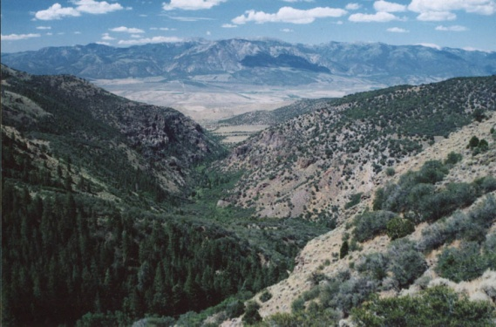
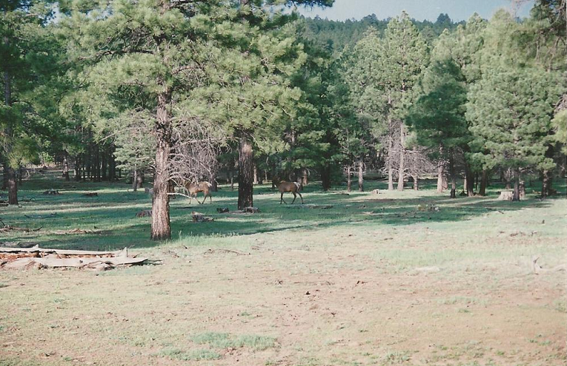
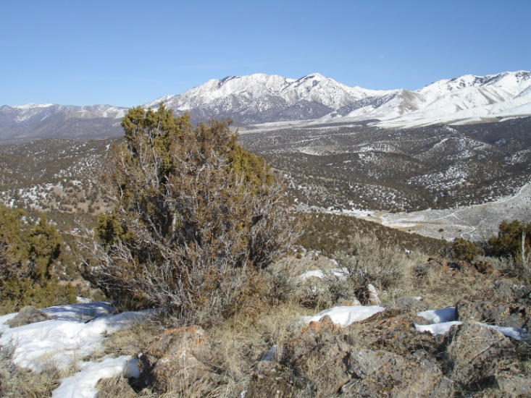
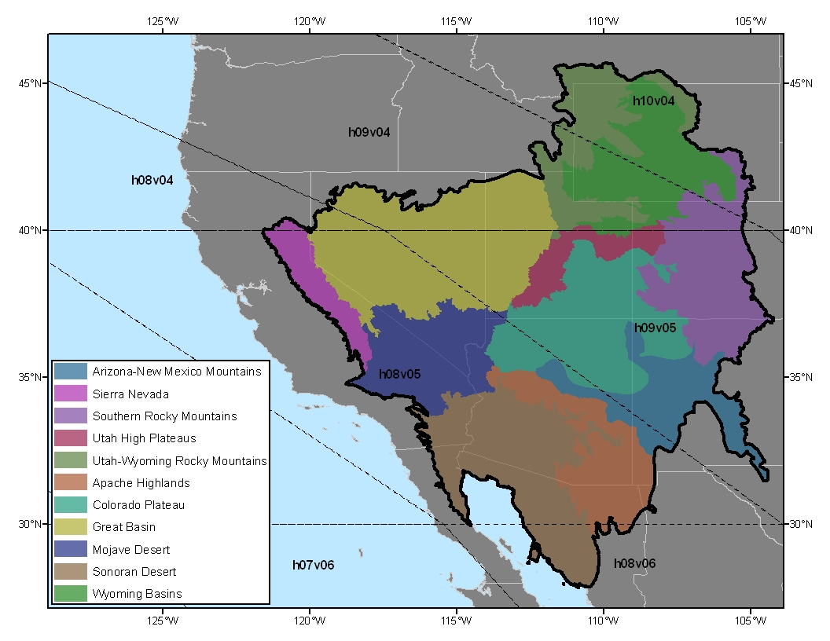
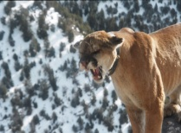
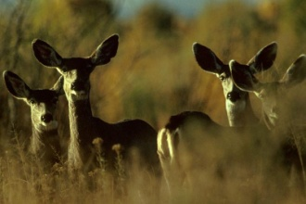
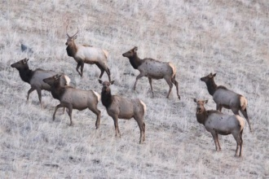
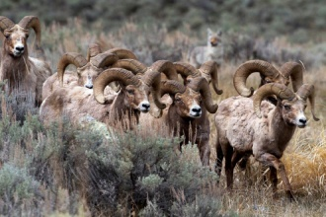
Research Study Region
Where We Work and What We Study
WY
NV
UT
CO
Portions of 9 ecoregions
AZ
NM
CA
Spatial extent: ~1.5 million km²
2015 Research Progress Review, College Park, MD 22-23 April 2015
NASA Funding Opportunity #NNH11AR55I

Slide 9
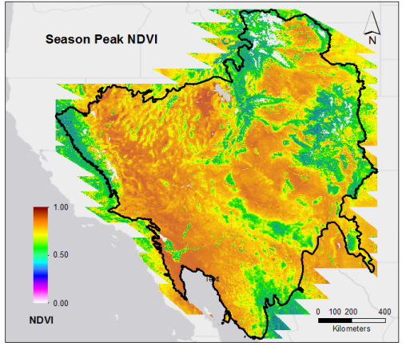
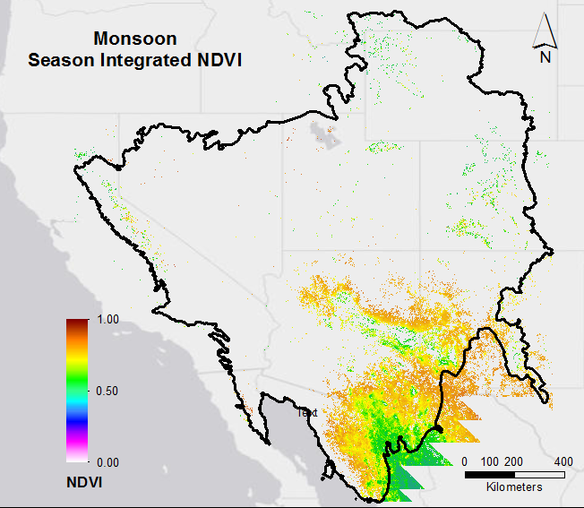
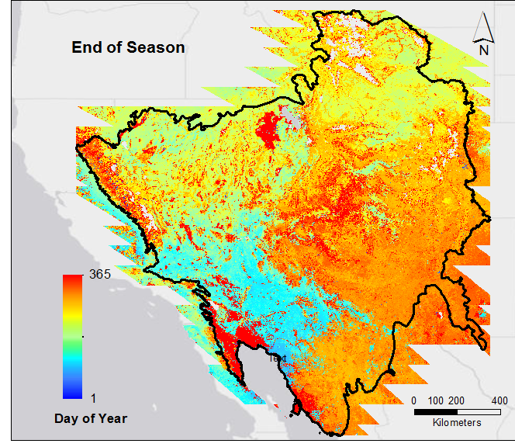
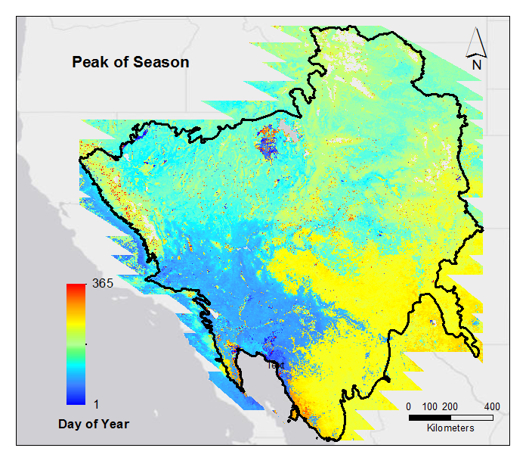
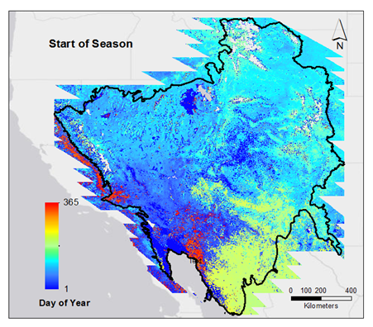
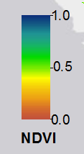
Our Principal Data Layer
Vegetation Metrics from MODIS – The “NDVI Stacks”
YEAR
MODIS NDVI (2000-2014, daily, 500 m)
Response Variable = NDVI; scaled 0-1
2014
Julian dates 0001–5475
( 1 Jan 2000 to 31 Dec 2014)
2000
2015 Research Progress Review, College Park, MD 22-23 April 2015
NASA Funding Opportunity #NNH11AR55I

Slide 10
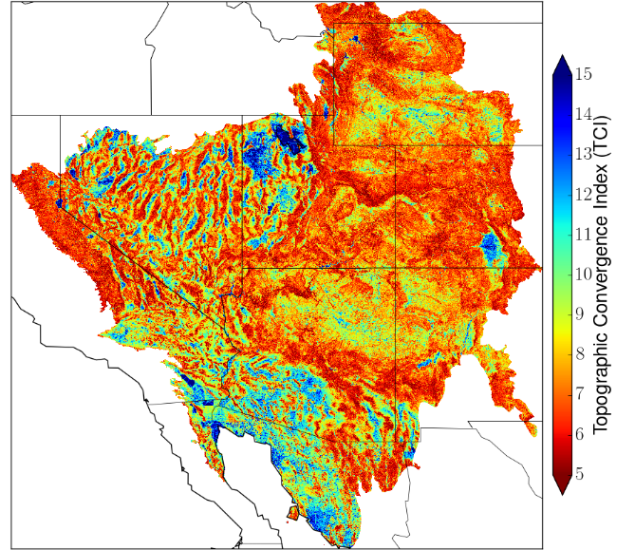
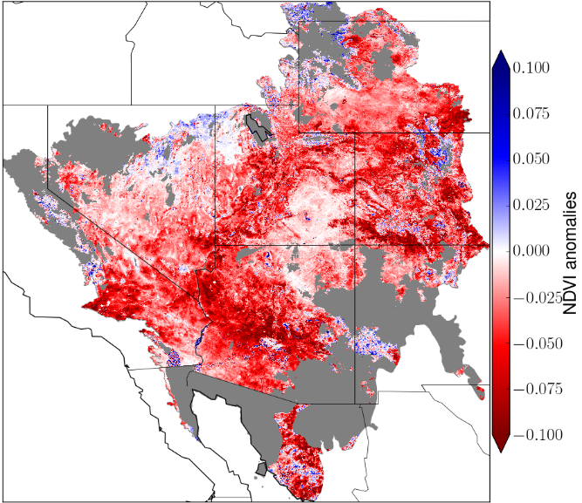
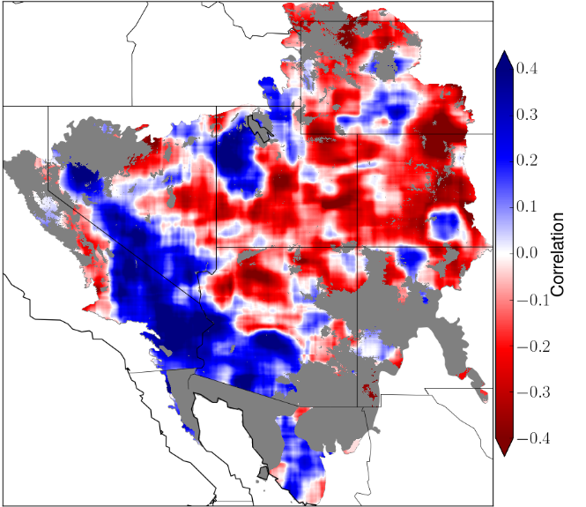
Module #1: Effects of Topography on the Responses of Ecosystems to Drought
Context:
  Drought reduces vegetation growth (& NDVI signals we are using)
  Topography affects system resiliency by redistributing water within catchments
  Can we use a topographical convergence index (TCI) to model the capability of a catchment to be a water “sink” in time of drought?
TCI Index
NDVI anomalies
TCI & NDVI correlation
2015 Research Progress Review, College Park, MD 22-23 April 2015
NASA Funding Opportunity #NNH11AR55I

Slide 11
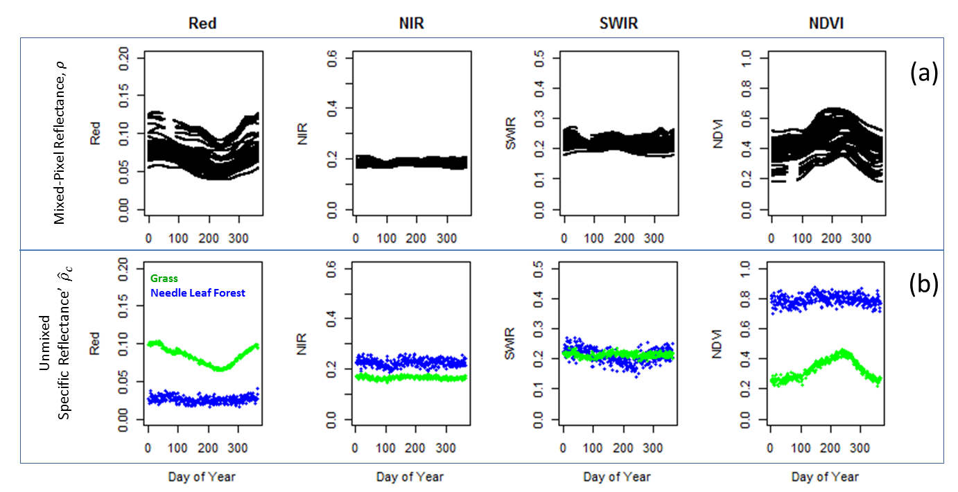
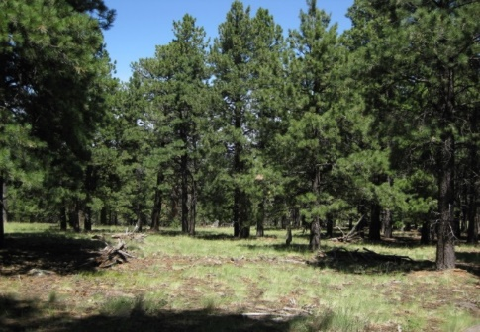
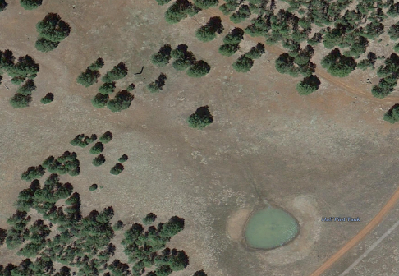
Module #2: Retrieving Plant-Specific Phenologies by Spectral Unmixing
Context:
  How to extract forage-specific phenology from mixed NDVI pixels?
Mixed pixel Reflectance
Broad ecotonal savannah comprised of evergreen trees (Ponderosa pine) and seasonal grasses.
Un-Mixing
Land-Cover
Specific Reflectance
Land-Cover Specific NDVI
Pixel LULC Proportions
2015 Research Progress Review, College Park, MD 22-23 April 2015
NASA Funding Opportunity #NNH11AR55I

Slide 12
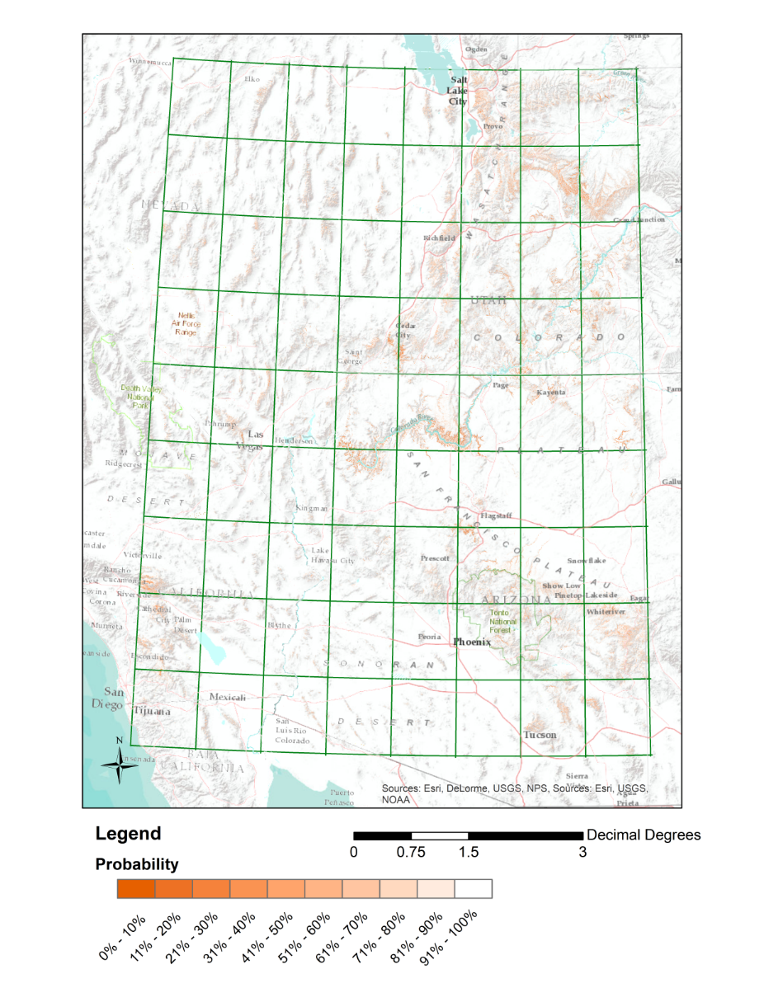
Module #3: Environment and Detection Biases in GPS Collars
Context:
  Environmental factors – especially topography - interfere with GPS collar satellites and result in missed fixes
  Modeled these effects on detection
  Result is USGS map product on GPS collar detection bias
  Can be used to “adjust” collar locations for large mammals (by species: cougar, mule deer, elk, rocky mountain bighorn)
2015 Research Progress Review, College Park, MD 22-23 April 2015
NASA Funding Opportunity #NNH11AR55I

Slide 13
Module #4: Using NDVI to Measure Trade-offs Between Prey Foraging and Predator Avoidance
Context:
  In the Intermountain West, ungulates track primary productivity as measured with NDVI
    However, green-up pattern different in deserts
  In deserts, bighorn sheep balance forage needs with predator avoidance by selecting for escape terrain
  Within escape terrain, NDVI is related to visibility (e.g., shrubs) &/or food (e.g. high quality annuals)
Locations by sex on escape terrain:
≥ 40% slope &
Vector Ruggedness Measure,
vrm>0.002
2015 Research Progress Review, College Park, MD 22-23 April 2015
NASA Funding Opportunity #NNH11AR55I
Notes:
Main Pts: Within escape terrain, ewes choose sites with lower NDVI when they have lambs (Jan-Mar solitary, Apr-Jun in groups); and use sites closer to matching available NDVI as lambs mature.

Slide 14
Module #4: Using NDVI to Measure Trade-offs Between Prey Foraging and Predator Avoidance
Context:
  Higher NDVI = both ↑ forage biomass & ↑ stalking cover (i.e., predation risk)
  Bighorn females with young select locations based on avoiding predation risk over high levels of plant productivity, as indexed by NDVI
  During the fall, when risk avoidance is most relaxed, sheep select the least rugged areas when in escape terrain, with NDVI levels more closely related to those available
Mother w/young
Female sheep foraging locations in areas of lower NDVI signal. “Peaks” represent mother with young
2015 Research Progress Review, College Park, MD 22-23 April 2015
NASA Funding Opportunity #NNH11AR55I

Slide 15
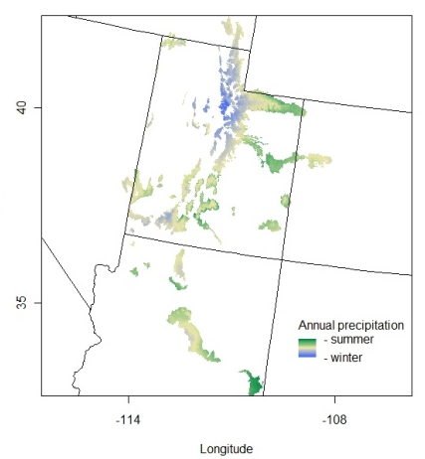
Module #5: Mammalian Reproduction Tracks Plant Phenology Across a Latitudinal Gradient
Context:
  Do deer birthing schedules track local plant phenological signals?
  Which month best predicts mean &variance in juvenile production?
  Does juvenile production vary with timing and form of precipitation?
Latitude
Longitude
2015 Research Progress Review, College Park, MD 22-23 April 2015
NASA Funding Opportunity #NNH11AR55I

Slide 16
Module #6: Deer Population Dynamics Based off Primary Productivity and Climate
Context:
  Create primary productivity Integrated Projection Models based off primary productivity-climate relationships
  Demographic parameters linked back to basic NDVI values
2015 Research Progress Review, College Park, MD 22-23 April 2015
NASA Funding Opportunity #NNH11AR55I

Slide 17
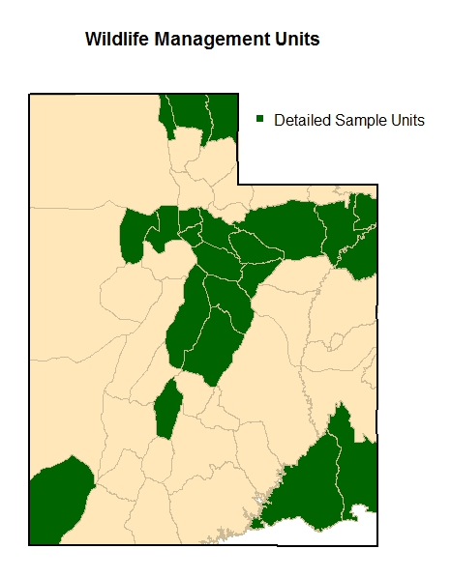
Module #6: Deer Population Dynamics Based off Primary Productivity and Climate
Context:
  Demographic parameters linked back to basic NDVI values
NDVI & CLIMATE
DOE:FAWN & ABUNDANCE
Phase I
Phase II
SURVIVAL & FECUNDITY
Predictor variables
Response variables
2015 Research Progress Review, College Park, MD 22-23 April 2015
NASA Funding Opportunity #NNH11AR55I

Slide 18
Module #7: Prey abundance, home range size, and carnivore density along productivity gradients
Context:
  How do primary consumers respond to spatial variation in primary production?
  How do secondary consumers respond to spatial variation in prey abundance?
2015 Research Progress Review, College Park, MD 22-23 April 2015
NASA Funding Opportunity #NNH11AR55I

Slide 19
#8: Movement and space selection in a dynamic resource environment
Context:
  How to assess resource selection when the background environment (NDVI-based phenology) changes daily – as does the selection by the animal – is a non-trivial exercise
  And in the interest of transparency, we’re stumbling a bit here !!
t₀ => 3G, 3R, 2Y
t₁ => 2G, 2R, 4Y
t₂ => 4G, 3Y, 1B
t₃ => 2G, 6Y
W_{i..k|t} = (.375,.375,.25)
W_{i..k|t} = (.25,.25,.5)
W_{i..k|t} = (.5,.375,.125)
W_{i..k|t} = (.25,.75)
2015 Research Progress Review, College Park, MD 22-23 April 2015
NASA Funding Opportunity #NNH11AR55I

Slide 20
#8: Movement and space selection in a dynamic resource environment
Context:
  Attempting some dynamic Brownian bridge models coupled with stopover assessment
2015 Research Progress Review, College Park, MD 22-23 April 2015
NASA Funding Opportunity #NNH11AR55I

Slide 21
Conclusions and Next Steps
Strong linkages exist between climate, NDVI, animal performance and movement
Modelling climate × land-use projections
  Dynamic (seasonal) habitat-use maps
  Carnivore functional responses to NDVI, prey, and landscape fragmentation
Predator Density & Distribution
Prey Density & Distribution
Climate & Weather
Topography
Primary Productivity
2015 Research Progress Review, College Park, MD 22-23 April 2015
NASA Funding Opportunity #NNH11AR55I

Slide 22
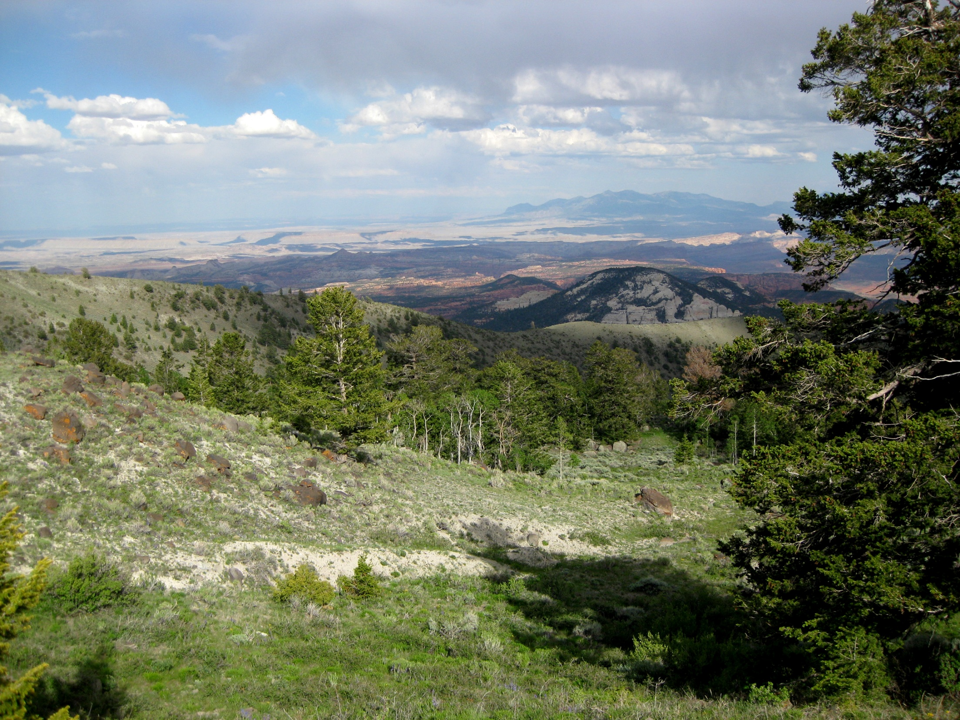
Questions?
2015 Research Progress Review, College Park, MD 22-23 April 2015
NASA Funding Opportunity #NNH11AR55I

